Slide 1
Linear Algebra
Mathematics of data

Slide 2
What is linear algebra?
Linear algebra is about linear combinations.
Arithmetic on columns of numbers called vectors
Arithmetic on arrays of numbers called matrices
study of lines and planes, vector spaces and mappings
Following describe a line on a two-dimensional graph
y = 4 * x + 1
different values into the x to find out what the equation or model does to the value of y
X is independent variable
Y is dependent variable

Slide 3
What is Linear Algebra?
We can line up a system of equations with the same form with two or more unknowns
y = 0.1 * x1 + 0.4 * x2
y = 0.3 * x1 + 0.9 * x2
linear algebra notation
y = A . b
no single line that can satisfy all of the equations without error
can have an infinite number of solutions

Slide 4
Applications?
Matrices in Engineering, such as a line of springs.
Graphs and Networks, such as analyzing networks.
Markov Matrices, Population, and Economics, such as population growth.
Linear Programming, the simplex optimization method.
Fourier Series: Linear Algebra for functions, used widely in signal processing.
Linear Algebra for statistics and probability, such as least squares for regression
Modeling many natural phenomena

Slide 5
Divided into
Arrays
Vectors
Matrices
Types of Matrices
Matrix Operations
Matrix Factorization
Statistics

Slide 6
Arrays: Collection of fixed type
from numpy import array
Create
cars =array( ["Ford", "Volvo", "BMW"])
NumPy arrays have a fixed type.
This means, for example, that if you attempt to insert a floating-point value to an integer array, The value will be silently truncated.
Access elements
cars[0]
Slicing
cars[start:stop:step]

Slide 7
Arrays
There are many ways to create NumPy arrays
from numpy import array
A = array([[1,2,3],[1,2,3],[1,2,3]])
from numpy import empty
A = empty([3,3])
from numpy import zeros
A = zeros([3,5])
from numpy import ones
A = ones([5, 5])

Slide 8
Ufunction / vectorized operation
def compute_reciprocals(values):
output = np.empty(len(values))
for i in range(len(values)):
output[i] = 1.0 / values[i]
return output
values = np.random.randint(1, 10, size=5)
compute_reciprocals(values)

Slide 9
Ufunction / vectorized operation
Vectorized operations in NumPy are implemented via ufuncs, whose main purpose is to quickly execute repeated operations on values in NumPy arrays
1.0 / big_array
np.arange(5) / np.arange(1, 6)

Slide 10
Vectors
A one-dimensional array
list or column of scalars
Row vector : horizontally (i.e., rows)
Column vector: vertically (i.e., columns)
# Load library
import numpy as np
# Create a vector as a row
vector_row = np.array([1, 2, 3])
# Create a vector as a column
vector_column = np.array([[1], [2], [3]])

Slide 11
Vectors
Vector Addition
c = a + b or np.add(a,b)
Vector Subtraction
c = a – b or np.subtract(a,b)
Vector Multiplication
c = a * b or np.multiply(a,b)
Vector Division
c = a / b or np.divide(a,b)
Vector Dot Product
c = a.dot(b) or np.dot(a,b)
Vector-Scalar Multiplication
c = a * 2.2
Vector Norm
from numpy.linalg import norm
l2 = norm(v)
.

Slide 12
Matrices
Matrices
A matrix is a two-dimensional array of scalars
# Load library
import numpy as np
# Create a matrix using np.mat (strictly 2D)
matrix_object = np.mat([[1, 2], [1, 2], [1, 2]])
# Create a matrix using np.array (operations performed element wise)
matrix = np.array([[1, 2], [1, 2], [1, 2]])

Slide 13
Matrices
Matrix Addition
C = A + B
Matrix Subtraction
C = A – B
Matrix Multiplication (Hadamard / elementwise Product)
C = A * B
Matrix Division
C = A / B
Matrix-Matrix Multiplication (Dot Product)
C=A * B if matrix or C = A.dot(B) or or A @B (python >3-5)
Matrix-Vector Multiplication (Dot Product)
C = A.dot(b)
Matrix-Scalar Multiplication
C = A.dot(2.2)

Slide 14
Types of Matrices
Different types of matrices are often used as elements in broader calculations
Triangle Matrix
# lower
from numpy import tril
lower = tril(M)
# upper
from numpy import triu
upper = triu(M)

Slide 15
Types of Matrices
Diagonal Matrix
from numpy import diag
d = diag(M)
Identity Matrix
from numpy import identity
I = identity(3)

Slide 16
Matrix Factorization/Decomposition
Way of reducing a matrix into its constituent parts
Breaks a matrix down into its constituent parts to make other operations simpler and more numerically stable
It is like factoring of numbers like factoring 10 into 2*5

Slide 17
Matrix Factorization/Decomposition
LU Decomposition (square matrix into L and U mxm into three mxm)
from scipy.linalg import lu
P, L, U = lu(A) (A=L.U) or (A=P.L.U) LUP Decomposition
QR Decomposition (m x n matrix)
from numpy.linalg import qr
Q, R = qr(A, 'complete') (A=Q.R) Q=mxm, R=mxn
Eigendecomposition (square matrix into eigenvalue and eigenvector)
from numpy.linalg import eig
values, vectors = eig(A)
Singular-Value Decomposition
from scipy.linalg import svd
U, s, V = svd(A)

Slide 18
Matrix Operations
Matrix Transpose
B = A.T
Matrix Inversion
from numpy.linalg import inv
B = inv(A). Or A.I
Matrix Trace (sum of all diagonal)
from numpy import trace
B = trace(A)
Matrix Determinant
from numpy.linalg import det
B = det(A)
Matrix Rank from numpy.linalg import matrix_rank
r = matrix_rank(A)

Slide 19
Linear Algebra in Machine Learning
Dataset and Data Files
Images and Photographs
One-Hot Encoding
Linear Regression
Regularization
Principal Component Analysis
Singular-Value Decomposition
Latent Semantic Analysis
Recommender Systems
Deep Learning

Slide 20
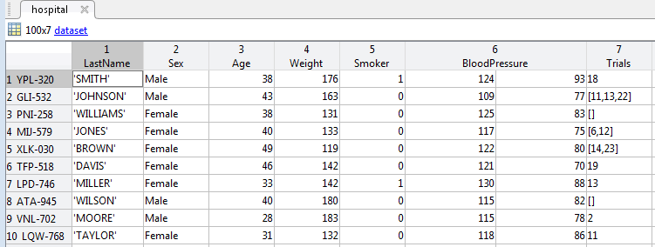
Dataset and Data Files
This is the table-like set of numbers where each row represents an observation and each column represents a feature of the observation

Slide 21

Images and Photographs
Operations on the image, such as cropping, scaling, shearing using linear algebra

Slide 22
One-Hot Encoding
The colour variable with the 3 rows
red
green
blue
Each row is encoded as a binary vector
red, green, blue
1, 0, 0
0, 1, 0
0, 0, 1

Slide 23
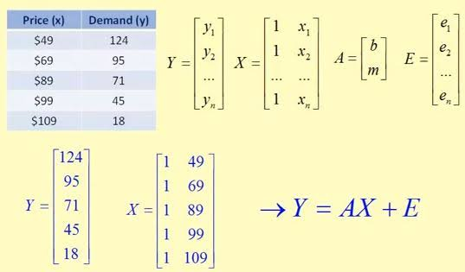
Linear Regression

Slide 24
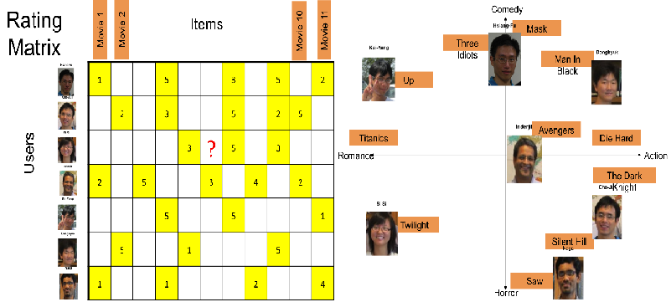
Recommender Systems

Slide 25
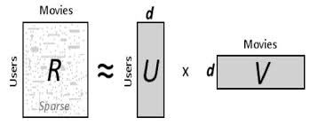
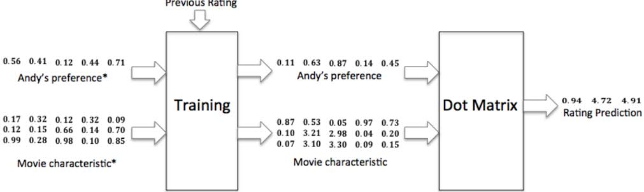
SVD PCA Matrix Factorization

Slide 26
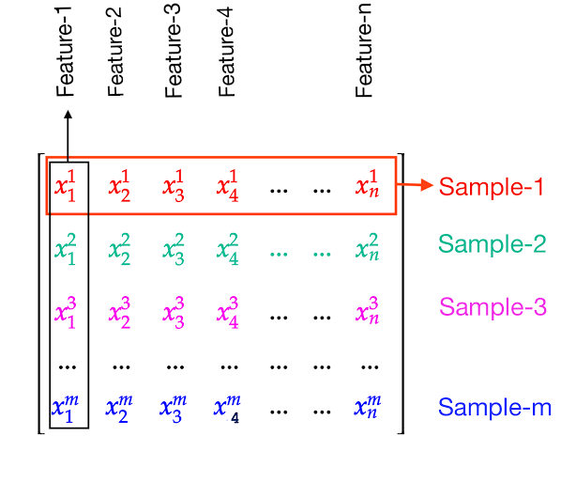
Deep Learning

Slide 27
Statistics
Statistics summarize the contents of vectors or matrices and are often used as components in broader operations
Mean
from numpy import mean
result = mean(v)
Variance
from numpy import var
result = var(v, ddof=1)
Standard Deviation
from numpy import std
result = std(v, ddof=1)
Covariance Matrix
from numpy import cov
sigma = cov(v1, v2

